Slide 1
Small Business Scoring ServiceSM
An Overview of the SBSSSM Solution
David K Smith
Small Business Segment Leader

Slide 2
Agenda
Who uses LiquidCredit SBSS?
What makes up the score?
How is the score delivered?
Why should we subscribe to use SBSS?

Slide 3

























Sample of Small Business Clients Using FICO LiquidCredit SBSS
#259
#205
#22
#133
#258
#430
#55
#103
#6
#40
#92
#123
#267
#18
#10
#299
#85
#410
#20

Slide 4
What Data is used in the Models?
Most Data Permutations are available for Term Loan and Lines of Credit models
Consumer Bureaus to Score Guarantors/Principals: TransUnion, Experian & Equifax.
  LiquidCredit obtains the bureau reports using YOUR subscriber codes
  The FI needs a direct contract with any one of the above bureaus.
Business Bureaus:
  Either of the following: Dun & Bradstreet (D&B), Experian & Equifax (with SBFE data).
Business Data Repositories & Data Consortiums:
  SBRI: Small Business Risk Insight — D&B and SBFE: Small Business Financial Exchange (via Equifax).
Application Data:
  Ex: Time as owner, Business DDA Balance, Percentage of Ownership…
Financial Data:
  Ex: Bus. Net Worth, Total Assets/Liabilities, Cash and Equiv…

Slide 5

The Breadth of FICO® Small Business Scoring ServiceSM solution
Total Model Segments Available:
70 Total
52 Term Loan/LOC
  Start Up
10 Leasing
7 Commercial Card
1 Personal Bankruptcy
1st Level of Segmentation:
Model Types
Term Loan/Line of Credit
Commercial Card
Leasing
2nd Level of Segmentation:
Data Sources
1 Consumer Bureau
1 Business Bureau
Financial Data
Application Data
1 Business Repository
(SBRI, SBFE)
Data Combinations Supported Specific Models
Coverage for all situations – with and without application, and/or consumer data, and/or financial, and/or business bureau data
Score Range
0 to 300
Most businesses score between 130 and 240
Low cut off scores range between 175 and 190
High cut off (Automated Approval) - 225
Definition of a ‘Bad’:
TL/LOC and Lease: Bankrupt, charged-off, or 3+ cycles delinquent
Commercial Card: 2+ cycles delinquent
Validated for Credit Amounts up to
$1,000,000 (Term Loan and LOC)
$250,000 (Leasing)

Slide 6






FICO® LiquidCredit® Service Workflow
LiquidCredit needs an LOS (calling system) to process applications
Step 1: The Application Data is entered into YOUR Origination System.
Step 2: YOUR LOS securely passes the application data to the LiquidCredit Service for processing.
Step 3: Credit bureau data is obtained using YOUR bureau credentials.
Step 4: Model is selected based on the data available.
Step 5: Characteristics are created, model is run, and reason codes created.
Step 6: All data, scores, and reason codes are returned to the calling system.
Application Scoring
Characteristics are created and application is scored. Reason codes created.
Your Loan
Origination
System
LiquidCredit uses 2FA for access to LC.
LiquidCredit
Service
Model
Selection
Loan
Officer
Secure
Connection
LiquidCredit utilizes model segmentation logic to determine the appropriate scorecard to use to generate the SBSS Score.
Data is secured in transit and at rest.
Data is protected.
SOC2, ISO27001, PCI-DSS
CRA Reports Obtained
LiquidCredit has no UI and is dependent on an LOS as a calling system
LiquidCredit uses customer subscriber IDs to obtain bureau reports from the requested bureaus (Cons/Bus).

Slide 7
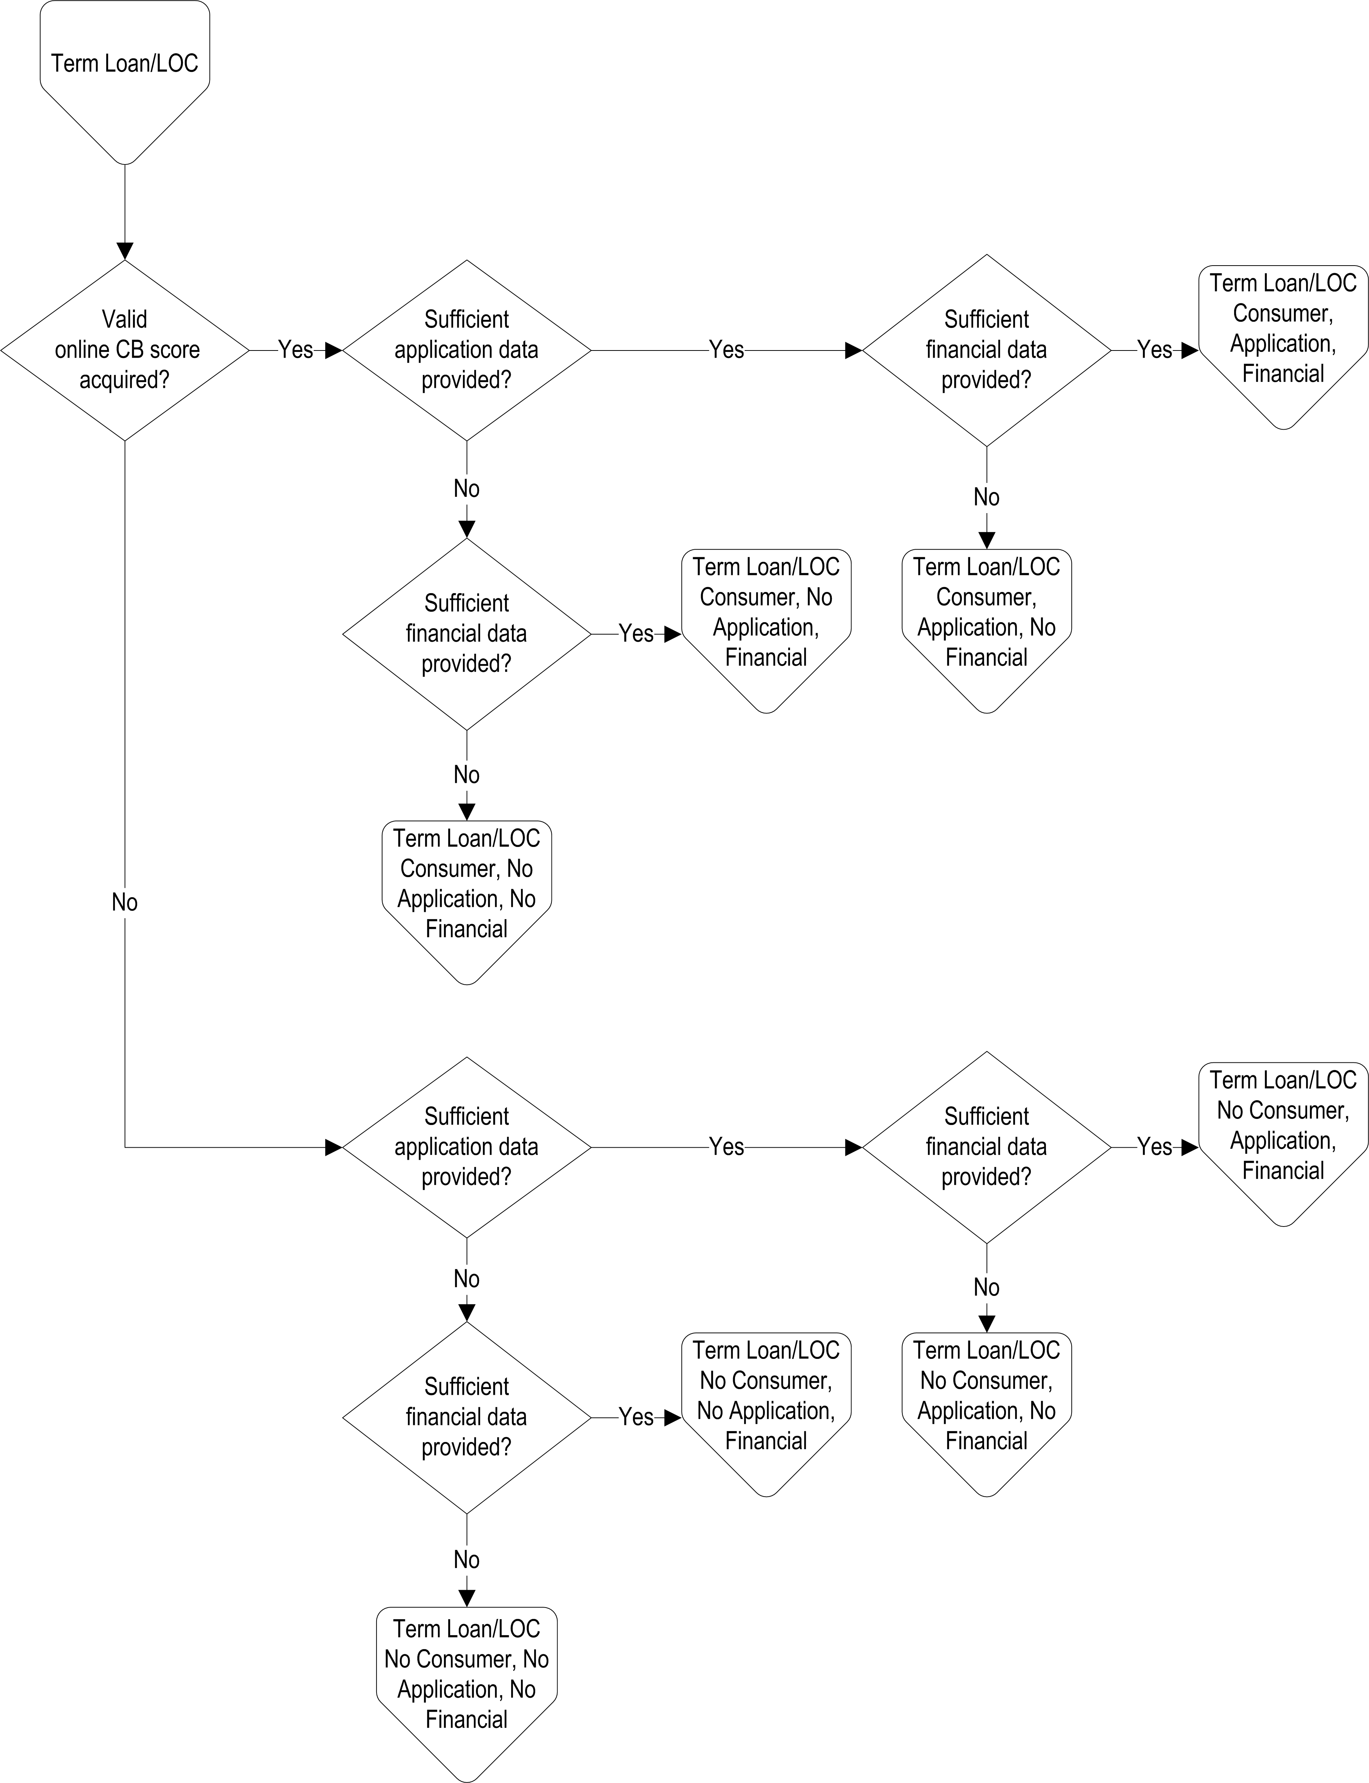






Models are Situation-Dependent
SBSSSM is a model suite with many scorecards
Selects right model for profile, data availability, credit need
‘Explainable’ Black Box Scoring Engine
Scorecard ID | Scorecard
701 | Term Loan & LOC—Consumer report
704 | Term Loan & LOC—D&B business, subpop TermLoan/LOC1
705 | Term Loan & LOC—D&B business, subpop TermLoan/LOC2
706 | Term Loan & LOC—Exp Bus report, subpop TermLoan/LOC3
707 | Term Loan & LOC—Exp Bus report, subpop TermLoan/LOC4
711 | Term Loan & LOC—Consumer credit report and application information
712 | Term Loan & LOC—Consumer report, application, and financial information
713 | Term Loan & LOC—Consumer report, application, and D&B business report
714 | Term Loan & LOC—Consumer credit, application, and Exp Bus report
715 | Term Loan & LOC—Consumer credit, application, and SBRI
Notes:
This is a foreshadow of next slide so audience understands that multiple models can exist side by side. Goal isn't to create one magic all-encompassing score that works for all cases.

Slide 8
LiquidCredit Small Business Scoring Service
LiquidCredit Service is a ‘black box’ scoring platform that delivers pooled small business and consumer application risk scores.
  A SOAP webservice using XML formatted data to exchange application and credit report information.
Small Business Scoring Service (SBSS).
  is an application risk score (not a ‘credit score’ that predicts the likelihood of major delinquencies, charge-off, or bankruptcy.
  Is used by 150+ banks, credit unions, and financial institutions.
  Utilized by the SBA for 7(a) loans under $500,000.
  Used by several Top 30 US banks, many mid-regional and consumer institutions, as well as equipment finance groups and many ag lenders.

Slide 9



How a Score is determined when Two Principals are Presented
Total Score
190
+
=
Principal Data
Application
Consumer Credit Bureau
Business Data
Application
Financials
Business Credit Repository
Total Score
197
+
=
*Lowest of the two scores is the ‘Final’ SBSS Score

Slide 10
How a Score is determined when Two Principals are Presented
+
Total Score
190
Principal Data
Application
Consumer Credit Bureau
Business Data
Application
Financials
Business Credit Repository
=
+
*Lowest of the two scores is the ‘Final’ SBSS Score

Slide 11







Adopting FICO® SBSS Provides Lenders Multiple Benefits
Create accurate strategies and more profitable opportunities
across your lending portfolio
Broaden the scope of applications you underwrite
Flexibility to use any combination of data to evaluate risk
Reduce risk at the point of origination
Improve consistency in lending decisions – remove bias
Automate small dollar loans
Stay in front of audit and regulatory requirements

Slide 12
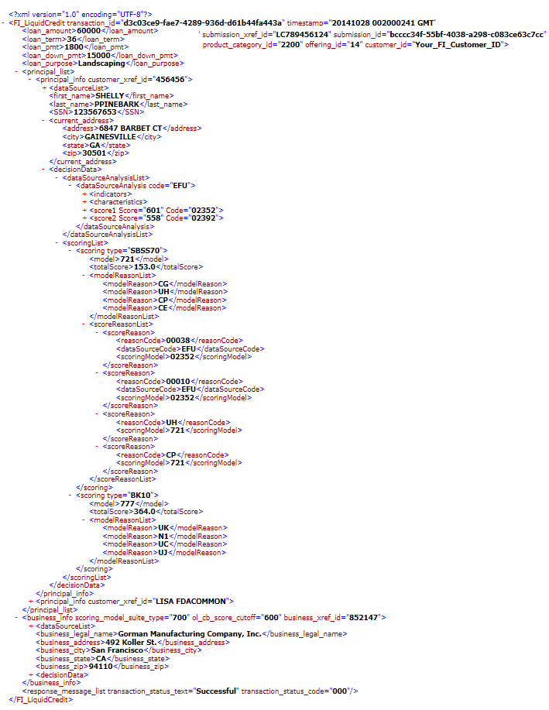
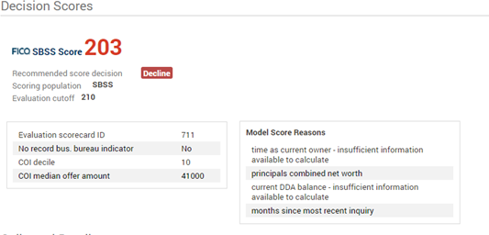
What do I get for my SBSS spend?
Scores
Returns up to 2 consumer scores on each Consumer report.
1 SBSS and 1 Principal Bankruptcy score per Principal.
Up to 5 Reason Codes.
Reports and Data
Consumer Report Print Images.
Parsed Consumer and Business Report Data.
Your LOS creates the ‘look and feel’ of the XML data.

Slide 13
The Predictive Power
of SBSS 7.0

Slide 14
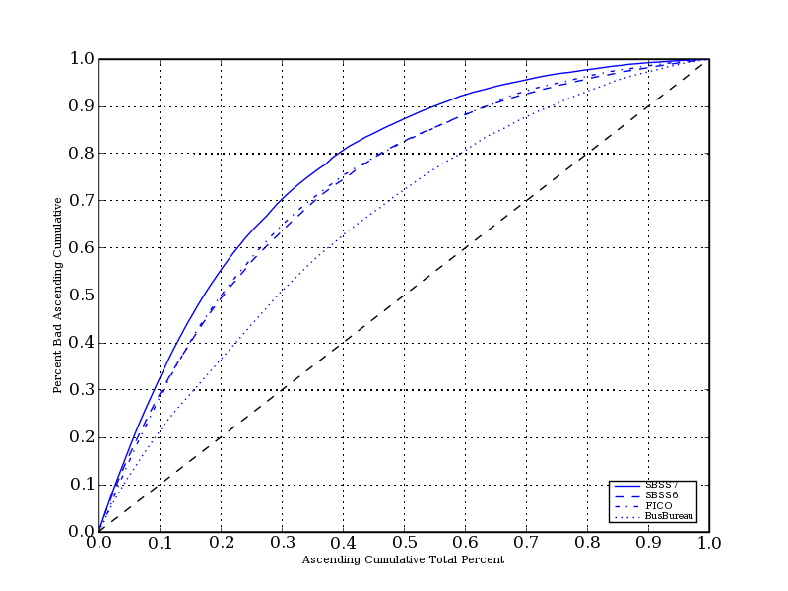
Comparison of predictive power
SBSS 7.0: Full applicant population

Slide 15
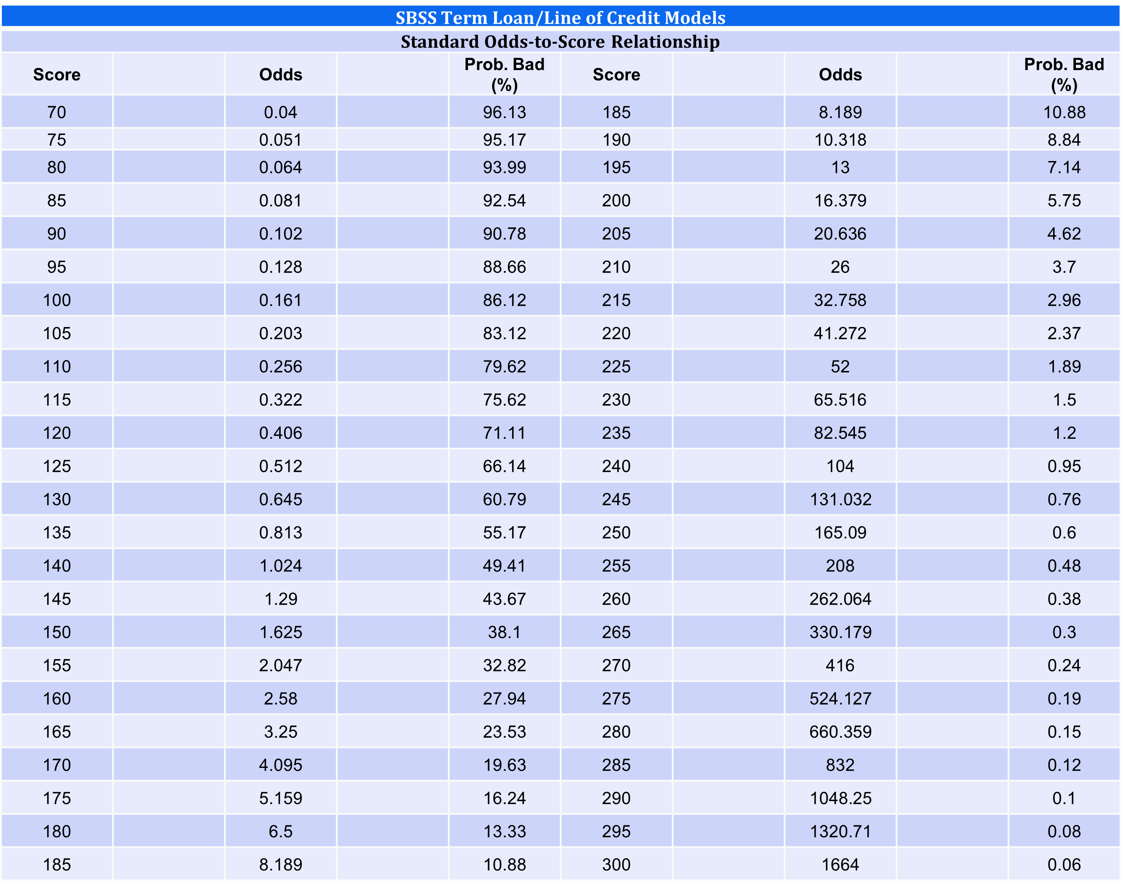
Overall SBSS Odds to Score Ratio
Term Loan/Line of Credit Models

Slide 16
SBSS 7 Metrics: Term Loan/Line of Credit Models
D&B Bureau
SBSS 7.0 Term/LOC | KS | Divergence | ROC Area | Gini
Consumer Bureau Only | 0.470 | 1.529 | 0.805 | 0.611
Consumer Bureau + Application | 0.473 | 1.609 | 0.808 | 0.617
Consumer Bureau + Business Bureau + Application | 0.478 | 1.627 | 0.811 | 0.621
Consumer Bureau + Business Bureau + Application + Financials | 0.541 | 2.241 | 0.845 | 0.690

Slide 17
Area Under the Curve – Term/LOC – Experian Business Data
Term/Loc Models | ROC Area
Consumer only | 0.805
Consumer + Application | 0.808
Consumer + Experian Business | 0.810
Consumer + Experian Business + Application | 0.811

Slide 18
SBSS 7.0 with and without Equifax/SBFE Performance
Term Loan/LOC |  |  | Without EFX/SBFE | With EFX/SBFE | % EFX/SBFE Improvement
1 Component | Consumer Bureau | KS | 0.47 | 0.49 | 3.43%
 | Only | Divergence | 1.53 | 1.70 | 10.84%
 |  | ROC Area | 0.81 | 0.81 | 0.99%
 | Financial | KS | 0.13 | 0.33 | 148.73%
 |  | Divergence | 0.11 | 0.75 | 602.83%
 |  | ROC Area | 0.59 | 0.73 | 24.23%
 | App | KS | 0.17 | 0.32 | 86.31%
 |  | Divergence | 0.20 | 0.68 | 244.67%
 |  | ROC Area | 0.62 | 0.72 | 15.59%
2 Components | Consumer + App | KS | 0.47 | 0.49 | 3.15%
 |  | Divergence | 1.61 | 1.73 | 7.40%
 |  | ROC Area | 0.81 | 0.82 | 0.99%
 | Consumer + Fin | KS | 0.51 | 0.53 | 2.77%
 |  | Divergence | 1.94 | 2.08 | 7.54%
 |  | ROC Area | 0.83 | 0.84 | 0.97%
 | App + Fin | KS | 0.22 | 0.36 | 65.83%
 |  | Divergence | 0.31 | 0.88 | 183.55%
 |  | ROC Area | 0.65 | 0.75 | 14.44%
3 Components | Cons + App + Fin | KS | 0.52 | 0.53 | 2.54%
 |  | Divergence | 1.98 | 2.13 | 7.16%
 |  | ROC Area | 0.83 | 0.84 | 0.84%

Slide 19
Term Loan Development Sample
Dispersion by credit request amount
Term loan and line of credit (amount in thousands)

Slide 20
LiquidCredit SBSS Pricing

Slide 21
SBSS Pricing
Tiered Pricing: The more you use, the cheaper they get:
Tier | Monthly Application Volume | Rate
1 | 0 to 85 | $21.60
2 | 86 to 340 | $14.86
3 | 341 to 850 | $11.00
4 | 851 to 3,400 | $5.50
5 | 3,401 to 6,500 | $2.00
6 | 6,501 to 25,000 | $1.10
7 | 25,001 to unlimited | $0.65
First Year Costs
  Fixed Cost: $15,000 Implementation Fee
  Buy through the tiers – App count starts over at 0 every month – Use 100 apps, then 85 are $21.60 and 15 are $14.86
  Minimums: Established during the contract phase and should be about 75% of your actual monthly volume
    Monthly minimums are paid annually up front (50 * $21.60 = $1,080, 12 * $1,080 = $12,960)
Monthly overages are charged in arrears. If Mins are 50, and 100 are transacted the overage is billed monthly:
  50 are pre-paid, 35 are billed at Tier 1 rate, $21.60, ($756) and 15 at Tier 2 rate, $14.86, ($222.90) totaling $978.90
CPI is applied after year one

Slide 22

Radically accelerate critical business outcomes
Let’s get started!

Slide 23
Index: SBSS Performance

Slide 24
Leasing Development Sample
Dispersion by credit request amount
Leasing
(amount in thousands)

Slide 25

Data effects on large transactions for Term/LOC models
SBSS 7 Metrics | Divergence | K-S
50K-<100K | 1.392 | 45.37
100K-200K | 1.628 | 47.78
200K-750K | 1.128 | 41.95

Slide 26
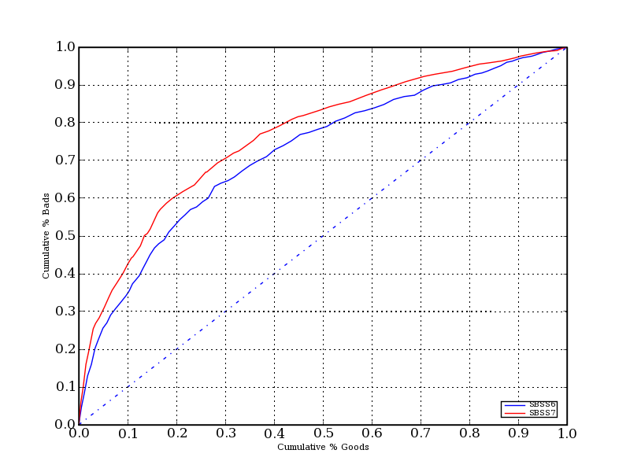
Amount Requested Greater Than $200K – KG vs KB
Amount Requested: 200,000+

Slide 27
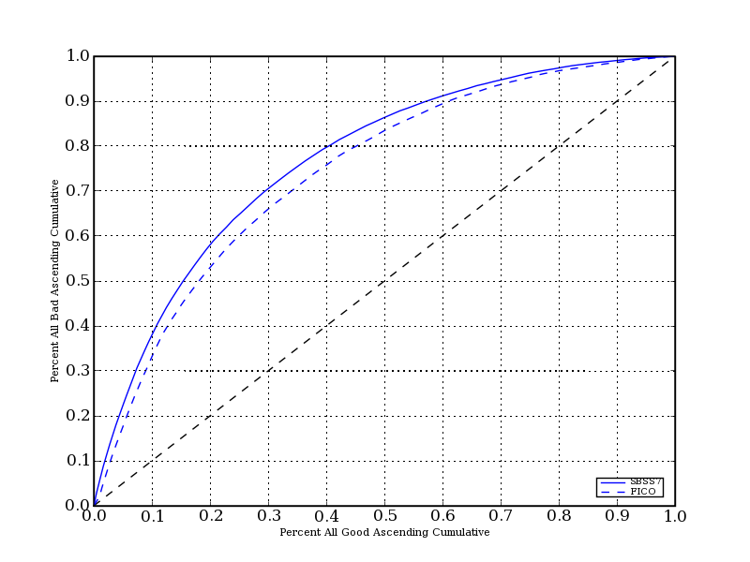
Comparison of predict power – Start-up
FICO vs. SBSS 7.0: Known good-bad population
Score | KS | Div | ROC area | Gini
FICO 8 | 34.26 | 0.503 | 0.738 | 0.476
SBSS 7.0 – Startup – Cons+App | 40.88 | 1.101 | 0.770 | 0.539

Slide 28
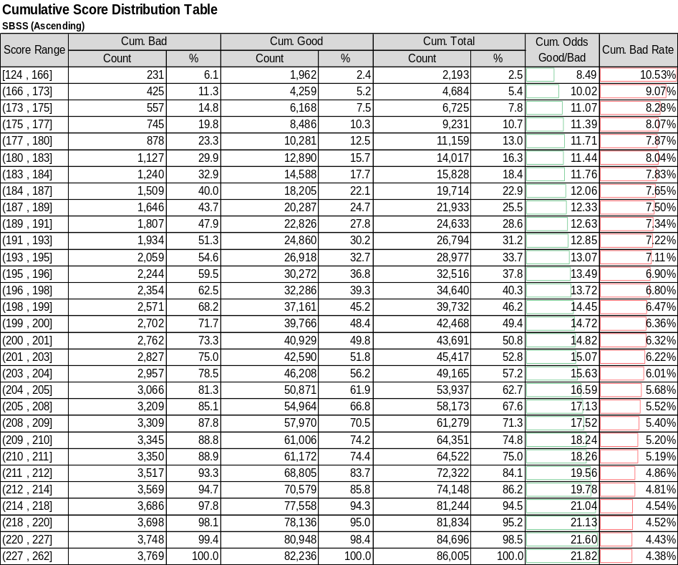
Customer Validation Results
FinTech Score Distribution and ‘Bad’ Rate
To assess the risk rank ordering.
  Higher the score lower the bad rate.
  Or Higher the score higher the odds (goods/bads).
Well distributed scores, reduced score clumping in particular score ranges.

Slide 29
Customer Validation Results
Large Northeastern Bank
Score | Divergence | ROC Area | Gini | KS | KS Score | KS Percentile | R-Squared
SBSS6* | 0.182 | 0.618 | 0.235 | 18.996 | 178.000 | 41.0 | 0.007
SBSS7* | 0.339 | 0.664 | 0.327 | 25.302 | 195.000 | 36.7 | 0.013

Slide 30
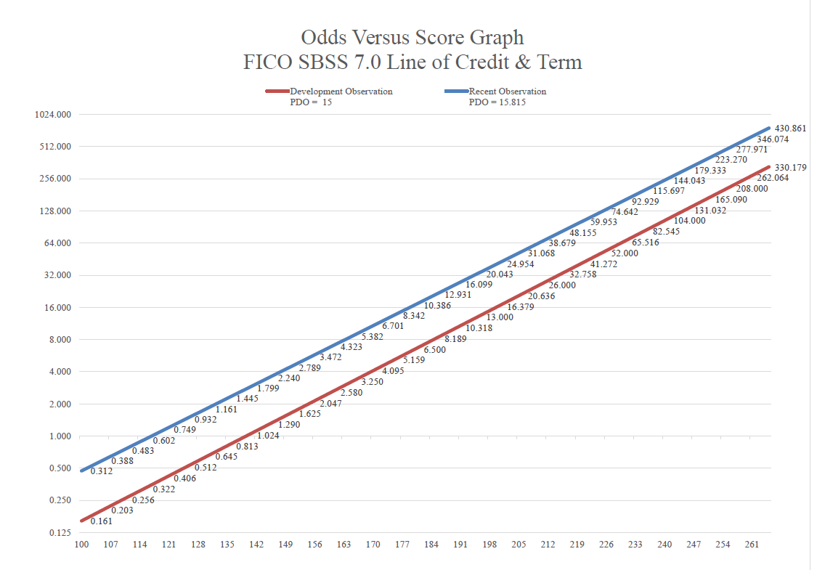
October 2020 Validation - SBSS 7
>$10B Midwest Bank, Performance March 2017 - March 2020
K-S of 37.5 @ 195
PDO (Points to Double Odds) – 15.815

Slide 31
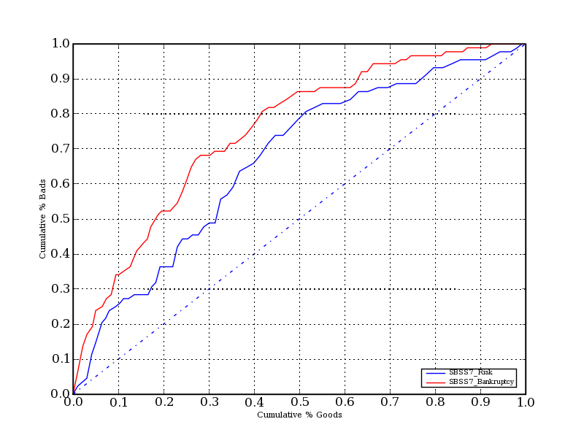
Why use the Bankruptcy Score
SBSS 7.0 Bankruptcy Score to be used in conjunction with SBSS 7.0 Risk Scores.
Better prediction of bankruptcy.

Slide 32
Explanation of Metrics

Slide 33
Trade off curves (AKA ROC Curve)
The purpose of a model is to separate goods from bads
At the point of scoring 10% of the population, the SBSS 7.0 score identifies 32% of the ‘bads’. 1
At the point of scoring 40% of the , the population SBSS 7.0 score identifies 80% of the ‘bads’. 2
The Area Under the Curve or ROC is the percentage of the figure that is covered under the curve.
2
1
Percent all bads
Percent all population

Slide 34
Sample Customer K-S Measurement
Score | Bads | Goods | Change
100 | 0.30% | 0.00% | 0.30%
105 | 1.00% | 0.00% | 1.00%
110 | 1.30% | 0.00% | 1.30%
115 | 1.30% | 0.00% | 1.30%
120 | 2.00% | 0.00% | 2.00%
125 | 2.70% | 0.00% | 2.70%
130 | 5.70% | 0.10% | 5.60%
135 | 7.40% | 0.30% | 7.10%
140 | 9.40% | 0.50% | 8.90%
145 | 13.10% | 0.01% | 13.09%
150 | 15.20% | 1.40% | 13.80%
155 | 18.90% | 1.90% | 17.00%
160 | 24.90% | 4.00% | 20.90%
165 | 32.30% | 6.40% | 25.90%
170 | 38.70% | 9.40% | 29.30%
175 | 46.10% | 13.70% | 32.40%
180 | 53.50% | 18.20% | 35.30%
185 | 60.30% | 24.10% | 36.20%
190 | 67.30% | 30.30% | 37.00%
195 | 75.40% | 37.90% | 37.50%
200 | 81.80% | 46.50% | 35.30%
205 | 87.90% | 57.00% | 30.90%
210 | 91.20% | 67.60% | 23.60%
215 | 94.20% | 76.70% | 17.50%
220 | 96.60% | 86.20% | 10.40%
225 | 99.00% | 93.10% | 5.90%
230 | 99.70% | 96.40% | 3.30%
235 | 99.70% | 98.40% | 1.30%
240 | 100.00% | 99.30% | 0.70%
245 | 100.00% | 99.50% | 0.50%
250 | 100.00% | 99.70% | 0.30%
255 | 100.00% | 99.80% | 0.20%
260 | 100.00% | 100.00% | 0.00%
265 | 100.00% | 100.00% | 0.00%
Cumulative % of Applicants
SBSS Score
K-S is the most commonly recognized measurement of model performance. It measures the maximum degree of separation between “goods” and “bads” by calculating the difference, in cumulative percent-to-total for each, at every score percentile group. While K-S is calculated for each score interval, the maximum value across all intervals is used as the score performance metric. A K-S value of 1.00 would indicate perfect separation.

Slide 35
Evaluating Scorecards - Kolmogorov-Smirnov (K-S)
100%
Calculating the K-S Statistic
BADS
K-S
CUMULATIVE % OF APPLICANTS
GOODS
0%
80 100 120 140 160 180 200 220 240 260 280
SCORE
K-S is the most commonly recognized measurement of model performance. It measures the maximum degree of separation between “goods” and “bads” by calculating the difference, in cumulative percent-to-total for each, at every score percentile group. While K-S is calculated for each score interval, the maximum value across all intervals is used as the score performance metric. A K-S value of 1.00 would indicate perfect separation.

